Slide 1

Reading Information Session for parents

Slide 2
Today’s session
A quick overview of the Read Write Inc programme
A look at the new Home reading structure
How to use the reading books with your child
Any questions
Future reading workshops
We will finish by 9.30

Slide 3
Reading link Teaching Assistants in each class:
2C – Mrs Cripps
2K – Mrs Curtis
1SW – Mrs Manley
1TW – Mrs Pengelly
Read Write Inc 1:1 tutor – Mrs Drewery
Read Write Inc Manager – Mrs Meek

Slide 4
We are teaching your child to read
But parents play a significant role:
in developing their child’s love of reading and books.
By praising, celebrating and recognising achievements parents can make their child’s journey to becoming a reader much, much more enjoyable.
Widening their child’s vocabulary through reading
Developing a wider knowledge of stories and texts in preparation for children’s writing

Slide 5
The Read Write Inc programme
Basically, the lessons are made up of:
Learning new sounds, then practising reading individual words.
Reading storybooks containing sounds they have learned.
Completing a variety of speaking and writing activities linked to the storybooks they have just read.
Learning new words and their meanings to use in their own writing

Slide 6
RED WORDS – words that cannot be sounded out
to make the word (these need to be learned ‘by sight’
– also known as key words)
For example: said want was one
GREEN WORDS – words that if you stretch them out
all the sounds can be heard (you can ‘sound them out’)
For example: dig dress ship three

Slide 7

How Fred Frog helps your child learn to read and spell..
Fred Frog only talks in individual sounds (not whole words)
He helps the children ‘sound out’ their Green Words
If he wants to say the word ‘chips’ he says ‘ch-i-p-s’. The children then build the whole word and say ‘chips’.
The children know this as Fred Talk. Fred Talk helps them sound out a word when they are reading.
Fred Talk helps children spell words when writing too.
If your child gets stuck on a word when
reading, ask them to Fred Talk it to you...

Slide 8
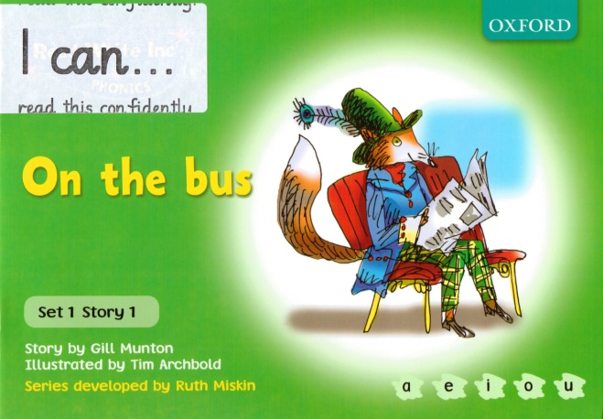
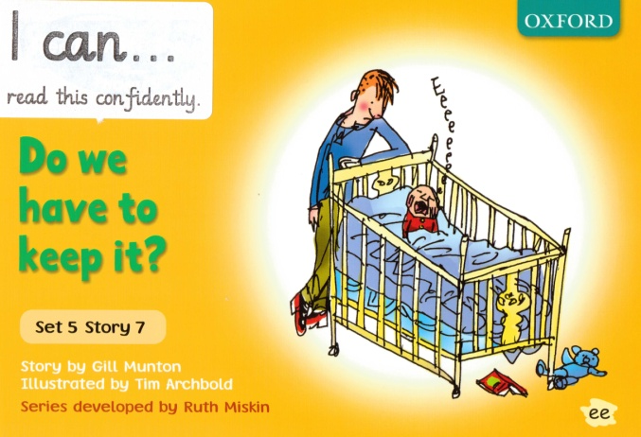
Home Reading Books – there are 3 books that we will be sending home
1. ‘I Can’ book - The new Read Write Inc book (labelled ‘I Can...read this confidently’)
Your child will have already read this at school and will have been taught all the sounds that make up the words in the book. They should be able to read MOST words without any help.
This book will be given to your child by their Read Write Inc teacher. They might not get a new ‘I Can’ book every week.

Slide 9
This book does have some structured activities inside that you could do with your child before and after they have read it.
We want this book to be a way of the children ‘showing off’ their reading skills to you. So give lots of praise and encouragement and celebrate when they read it confidently. Tell them how much their reading is improving each time they bring an ‘I Can’ book home.
They can read it to themselves at bedtime, you or another relative (an older/younger brother or sister) or even to a cuddly toy!
This book will have a return date label clipped to the front. Please do not remove the label, and make sure it
is returned to school by the date requested.
There is no need to record this book in the Home Reading
record book as we record that your child has read
this book at school.

Slide 10
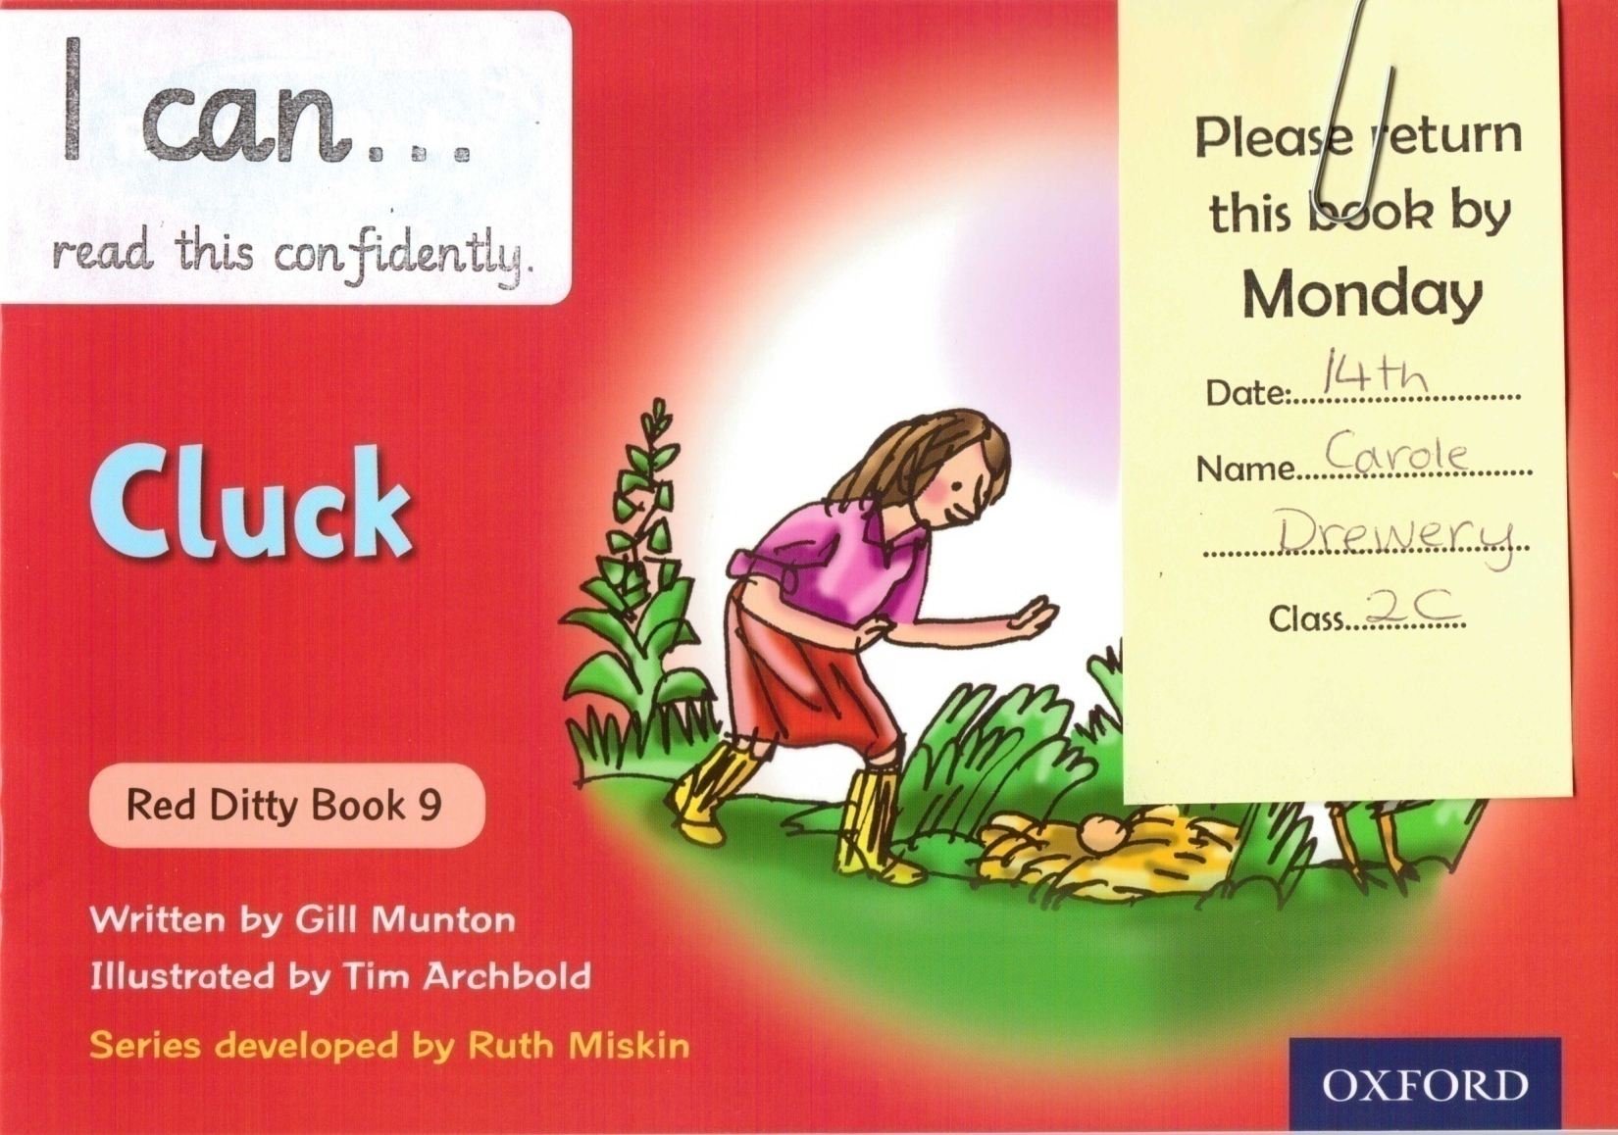
The new ‘I Can..’ books will start to be sent home at the end of this month!

Slide 11
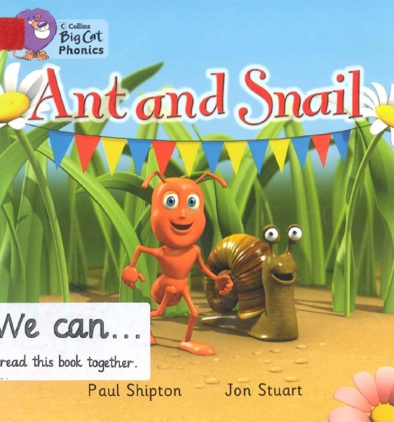

2. ‘We Can’ book – from the coloured book banded scheme
(labelled ‘We Can...read this book together’)
This book is closely matched to your child’s current reading level, but they will not have been taught all the sounds in all the words in the book. They will not be successful in reading the book without help.
This book can be changed as soon as the child has read it, but it is always a good idea to read the book more than once before returning it.

Slide 12
Your child should try to read some/all of the book but you will need to help them. This is not cheating! This book is extra reading practise so that your child can have experience of even more stories and learn more vocabulary
If they come across a tricky word don’t force your child to sound it out...tell them the word, ask them to say it too and then talk about what the word means
You might read the book to your child once before you try to read the book together with your child joining in where they can
You could take turns to read a page each or your child might just join in with words and phrases that are repeated
This book should be recorded in the Home Reading record book and signed before returning to school.

Slide 13
3. A library book
This book is completely your child’s free choice from our very well stocked library. Your child may choose stories, information books, poems, puzzle books or plays.
We hope that this book will encourage your child to get into the habit of reading a book for enjoyment’s sake
They might just want the book for the illustrations or the photographs in it. That’s OK...just spend some time talking about the pictures!
This is a book that you can read for your child entirely. Just as long as you both enjoy it...
We try to change library books regularly on a weekly basis.

Slide 14
Read Write Inc. Stage ICAN... | Reading book band Colour WE CAN...
Learning individual sounds and building words | Lilac
 | Pink
Ditty stage – reading a few words together | Red
Green Stage | Yellow
Purple Stage | Blue
Pink Stage | Green
Orange Stage | Orange
Yellow Stage | Turquoise
Blue Stage | Purple
Grey Stage | Gold
Comprehension Activities (no longer on Read Write Inc ‘I Can..’ books) | White
 | Black

Slide 15
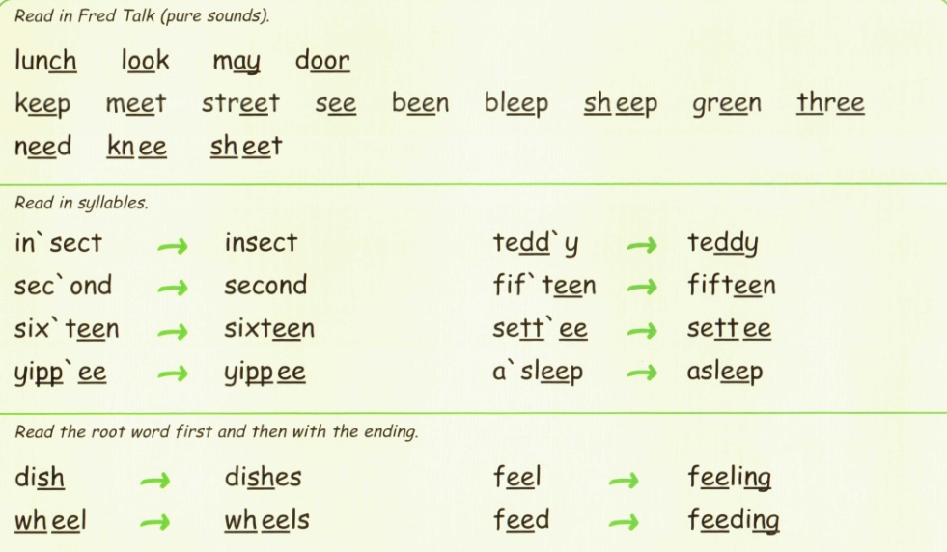
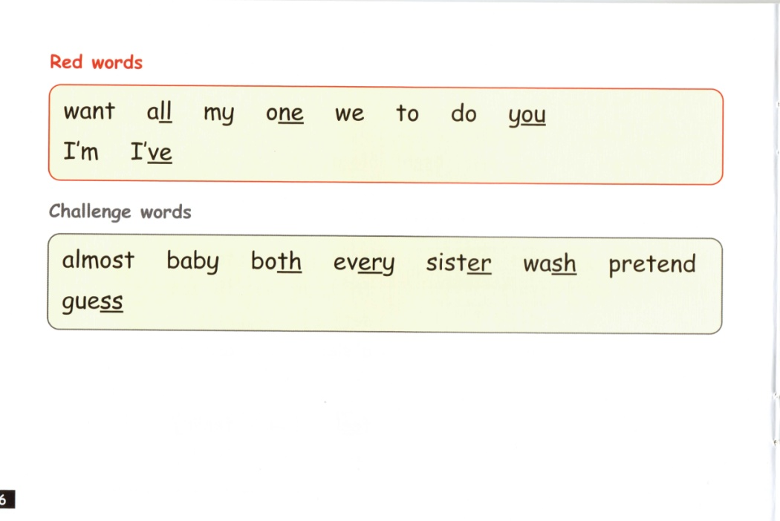
Activities within the new ‘I Can’ books
BEFORE READING THE MAIN STORY:
Read the Green and Red words page (and the Challenge Words if they appear):

Slide 16
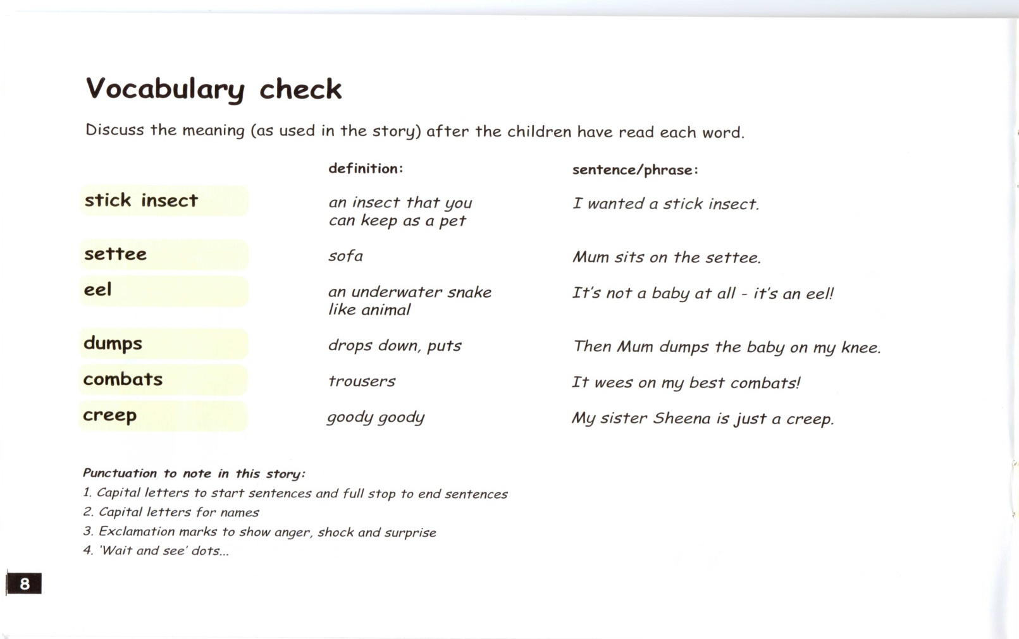
Activities within the new ‘I Can’ books
BEFORE READING THE MAIN STORY:
Read the Vocabulary Check page:

Slide 17
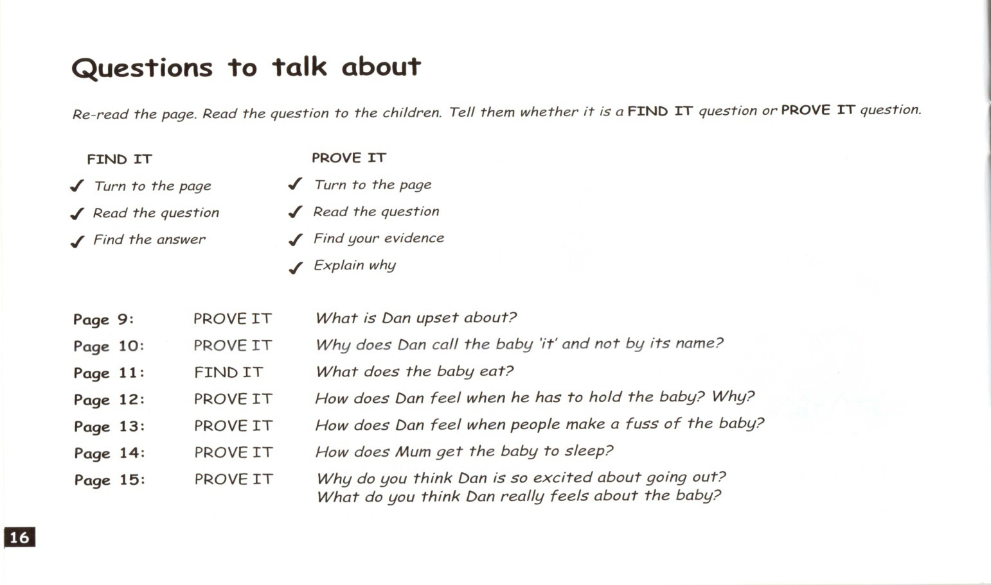
Activities within the new ‘I Can’ books
AFTER READING THE STORY:
Do the Questions to Talk about activity:
(Don’t do the Questions to Read and Answer page)

Slide 18
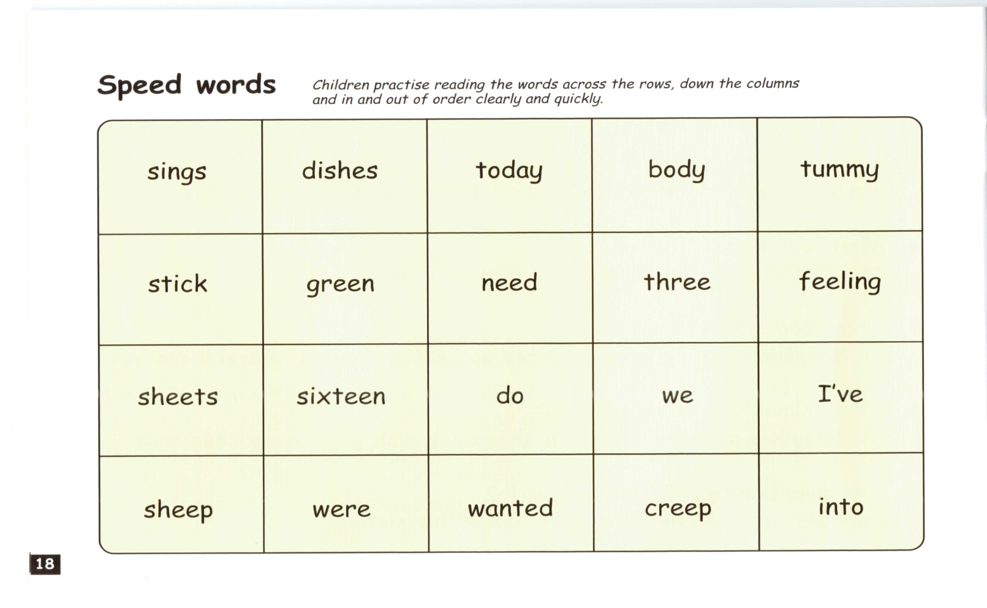
Activities within the new ‘I Can’ books
AFTER READING THE STORY:
Do the Speed Words activity on the last page:

Slide 19
How can you help your child?
Share books at home
Ask your child about what they have learned in their Read Write Inc lesson and get them to teach you
Please do not use letter names when sounding out new words
Use lots of praise
Attendance and punctuality
Keep all books in their book bag

Slide 20
Further information
There is a website where you can find further information about the programme www.readwriteinc.com or www.ruthmiskinliteracyprogramme.com
Take a leaflet which summarises the home reading scheme and gives advice on reading with your child
Any problems/questions ask the class teacher or the Reading TA in each class

